Slide 1
Uva 12846
A Daisy Puzzle Game
Time: 3 seconds

Slide 2
Problem Description (1)
Gretchen, a little peasant girl from the Swiss Alps, is an expert at the Daisy game, a simple game that is very well-known around the country.
Two players pluck of the petals of a Daisy fower, and each player is always at liberty to pluck a single petal or any two contiguous ones, so that the game would continue by singles or doubles until the victorious one takes the last leaf and leaves the “stump”—called the “old maid”—to the opponent.

Slide 3
Problem Description (2)
The pretty mädchen has mastered the Daisy game to such an extent that she always plays optimally.
In other words, she always plays by performing the best possible moves on each turn, a feat which never fails to astonish tourists who dare to challenge her to a game.

Slide 4
Problem Description (3)
Analyzing the game, it is not very complicated to fgure out a winning strategy for the second player, as long as the game starts with a complete fower (having all of its petals intact).
However, what will happen when Gretchen plays against an opponent that also plays optimally, and some of the fower’s petals have been plucked of at random?

Slide 5
Problem Description (4)
A fower is described by a number N which represents the original number of petals of the fower, and a list of the petals that have been plucked of.
All petals are numbered from 1 to N, and given the circular nature of the fower, that means petals 1 and N are originally adjacent. Given the description of a fower, and assuming it’s Gretchen’s turn, will she win the game? Remember that both players always play optimally.

Slide 6
Input
Input starts with a positive integer T, that denotes the number of test cases.
Each test case begins with two integers in a single line, N and M, representing the number of petals originally in the fower, and the number of petals that have been plucked of, respectively.
The next line contains M distinct integers, representing the petals that have been plucked of.
These numbers will always be in ascending order. T<=5000; 3<=N<=20; 1<=M<N

Slide 7
Output
For each test case, print the case number, followed by the string ‘yes’ if Gretchen wins the game, or ‘no’ otherwise.

Slide 8

Sample Input / Output
Number of test cases
2
13 1
7
5 3
1 3 4
Case 1: yes
Case 2: no
N: number of petals
M:number of petals
that have been plucked of
Petals that have been plucked of
1
4
3

Slide 9
Nim Game (組合遊戲)
兩人輪流取銅板，每人每次需在某一 Pile 取一枚或一枚以上的銅板，但不能同時在兩 Piles 取銅板，直到最後，將銅板拿光的人贏得此遊戲。
(換句話說, 不能拿的輸)

Slide 10
Examples
Case 1:
A 拿 1
B 拿 1
A 拿 1
B 不能拿
A勝
Case 2:
B 拿 1
A 拿 1
A 不能拿
B 勝
B 拿 1
A 拿 1

Slide 11
Examples
Assumptions:
我們都需要假設雙方都是足夠聰明
因此就會存在有判斷「先手勝」 或是「先手敗」 ，若是可以贏，不會故意不贏
Case 1:
先手勝
A 全拿
B 不能拿
A勝
Case 2:
先手敗
A 全拿
A 不能拿
B 勝
B 全拿

Slide 12
Case 2:
先手敗
A 拿 1
A 不能拿
B 勝
A 拿 1
B 拿 1
B 拿 1

Slide 13
先手必勝 vs 先手必敗
先手必敗狀態→ 所有的下個狀態都必勝
先手必勝→至少有一個下狀態為必敗
必勝
必敗
因為都夠聰明
怎樣走都沒用
因為都夠聰明
一定往這走
必敗
必勝
必勝
必勝
必勝
必勝
必勝

Slide 14
Nim Sum (L. Bouton 1902)
0 1
(1, 2, 3)
1 0
(a1, a2, a3)
→ a1 ⊕ a2⊕ a3
1 1
⊕
==0, 先手敗
0 0
!=0, 先手勝

Slide 15
Nim Sum (組合遊戲)
1 1 1 1
1 1 0 0
(15, 6, 10)
0 1 1 0
0 1 1 0
1 0 1 0
1 0 1 0
⊕
⊕
0 0 1 1
0 0 0 0
!=0 先手勝

Slide 16
SG(Sprague-Grundy) Function
SG函数，SG(x)=mex{ SG(y) | x→y }，
就是状态x能转移到y
mex(Y)表示非Y集合中最小的自然数
Example : mex(0,2)=1 mex(1,3)=0

Slide 17
Nim Game 只考虑一堆石头的情况
Recursive
SG(0)=0
因为(0)没有后继，所以自然SG(0)=0
SG(1)= mex(SG(0)=0)=1
SG(2)= mex(SG(0)=0, SG(1)=1)=2
...
SG(n)=n

Slide 18
Nim Game 考虑兩堆石头的情况
Recursive
SG(0,0)=0
SG(0,1)=SG(1,0)=mex(SG(0,0)=0)=1
SG(0,2)=SG(2,0)=mex(SG(0,1)=1 SG(0,0)=0)=2
...
SG(a,b)=a⊕b
必勝
(2,0)=(0,2)
(1,0)=(0,1)
(0,0)
必勝
必敗

Slide 19
Nim Game 考虑三堆石头的情况
必敗
(0,1,1)=(1,1,0)=(1,0,1)
必勝
Recursive
SG(0,0,0)=0
SG(0,0,1)=SG(0,1,0)=SG(1,0,0)=mex(SG(0,0,0)=0)=1
SG(0,1,1)=SG(1,1,0)=SG(1,0,1)=mex(SG(0,0,1)=1 SG(0,1,0)=1…)=0
...
SG(a,b,c)=a⊕b⊕c=SG(a)⊕SG(b)⊕SG(c)
(0,1,0)=(1,0,0)=(0,0,1)

Slide 20
回到本題的 SG Function
考慮一組連續花瓣的時候:
SG(0)=0 why??? (先手敗,因為無法拿)
SG(1)=mex{SG(0)=0}=1
SG(2)=mex{SG(0)=0, SG(1)=1}=2
SG(3)=mex{SG(1)=1, SG(2)=2, SG(1,1)=0}=3
SG(1)
SG(2)
SG(1,1)=SG(1)⊕SG(1)=0

Slide 21
回到本題的 SG Function
考慮一組連續花瓣的時候:
SG(4)=mex{SG(3)=3, SG(2)=2, SG(2,1)=3, SG(1,1)=0}=1
SG(1,1)=SG(1)⊕SG(1)=0
SG(1)
SG(2)
SG(1,2)=SG(2,1)=SG(2)⊕SG(1)=3

Slide 22
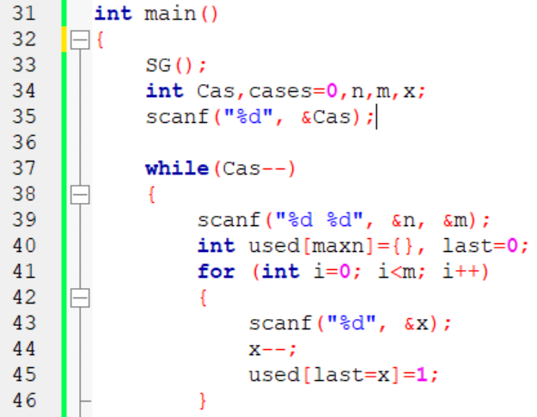

Slide 23
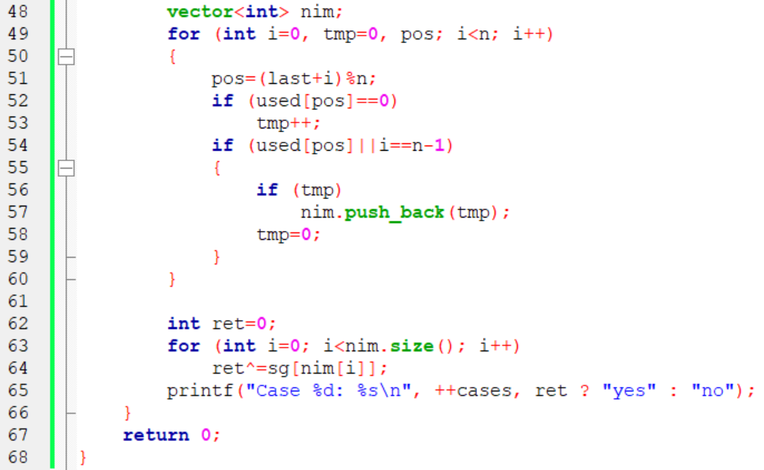

Slide 24
